Slide 1

Postman 2
API Testing Tool the easy way

Slide 2
Setting up
Creating Api calls
Managing collections and environments
Testing the results
Sharing and importing everything

Slide 3
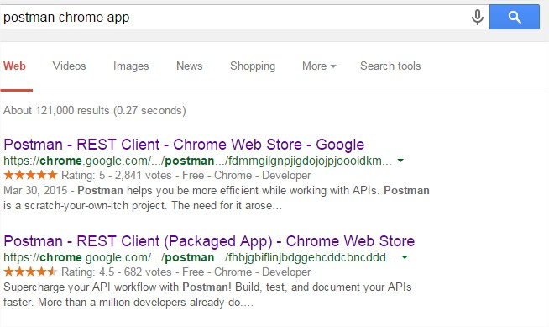
I. Setting Up
Postman 2 is a packaged chrome app : click the « Packaged App » link.
The first link corresponds to Postman 1, embedded in Chrome.

Slide 4
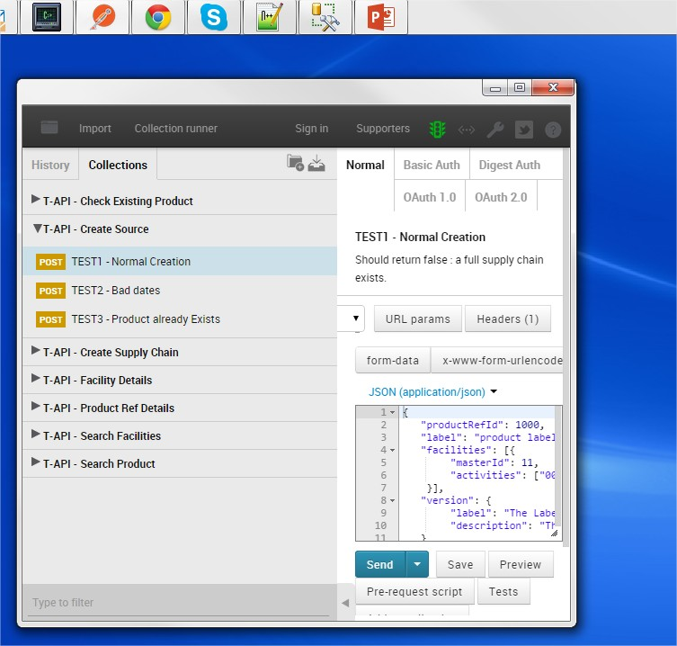
I. Setting Up
Launch the app with the chrome launcher, and that’s it.

Slide 5
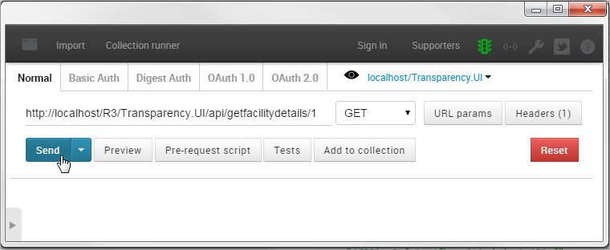
II. Creating API calls
GET : Fill in an URL, chose the method and Send

Slide 6
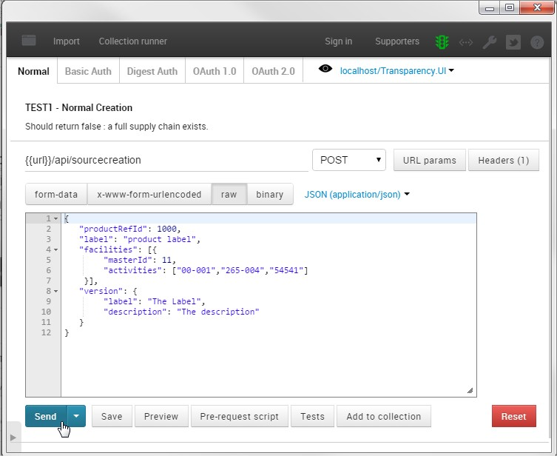
II. Creating API calls
POST : fill in the JSON data

Slide 7
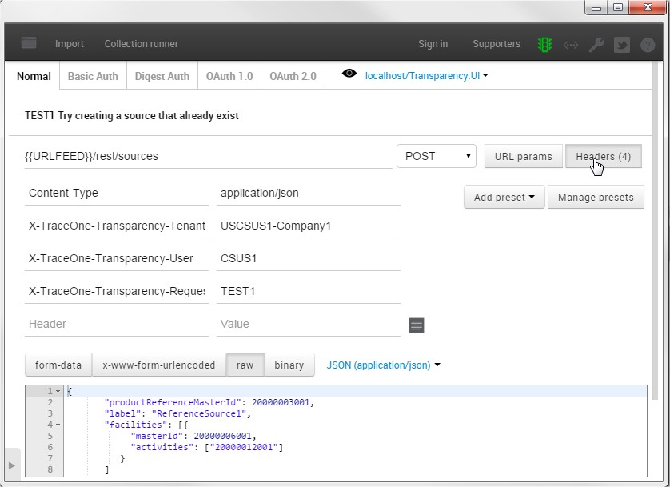
II. Creating API calls
You can add custom headers

Slide 8
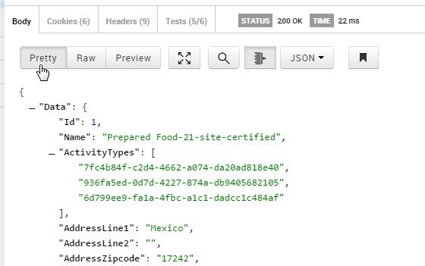
II. Creating API calls
Inspect the results (« Pretty » display is great)

Slide 9
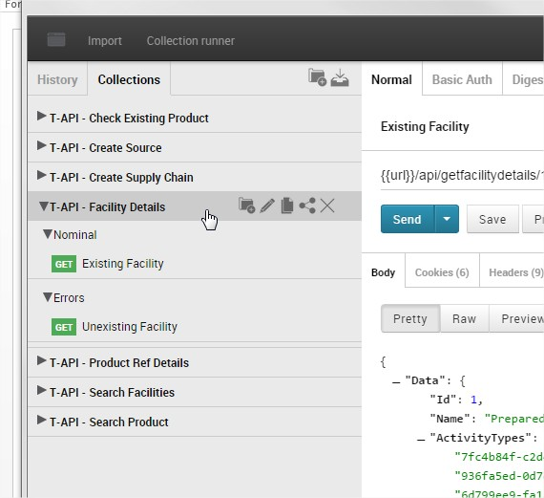
II. Managing collections and environments
You can put your postmen into collections (saved on your computer)
Collections can
Contain subfolders
Be modified
Be duplicated
Be shared
Be deleted

Slide 10
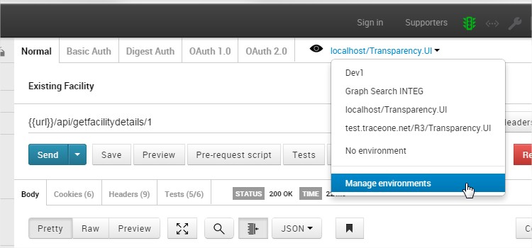
II. Managing collections and environments
You can make your collections unrelated to the environment tested

